Slide 1

Exploratory Analysis of
RTS accidents data

Slide 2

01 Data exploration
Catalog
02 Map Analysis
03 Absence Analysis

Slide 3

01 Data Exploration
Data set overview
Attributes analysis
Time Series

Slide 4
Dataset Overview
1.Accdate
2.AccTypeCode+AccSubTypeCode +Acctype
3.Retraining
4.Drv_Age +DrvSex
5.RoadwayLightConditions+Weather +RoadSurface
1
2
3
Absent days count before accident happen
Excuses Type
Master_ Scheduled day-off
Master_
Accident
Master_
Absence
Work Type vs. Accidents
Operator Information
Accident date / Location
Weather / Road Condition
Accident Type
Absence Type
Operator ID
Start/End time
Effective Date
Operator ID
Work Type

Slide 5
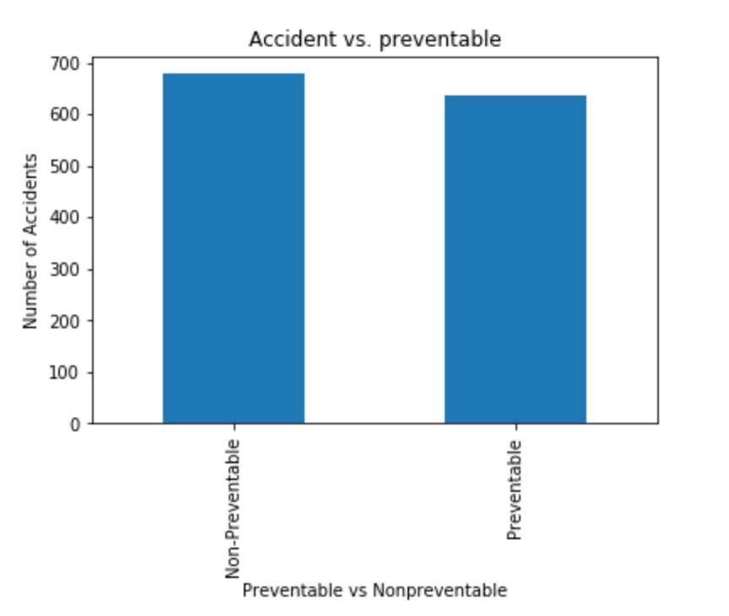
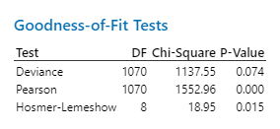
Attributes ANALYSIS
678
636
Half preventable / Half non-preventable
Analysis mostly focused on preventable accidents

Slide 6
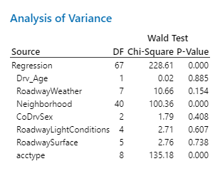
P-Value by Chi-Square test

Slide 7
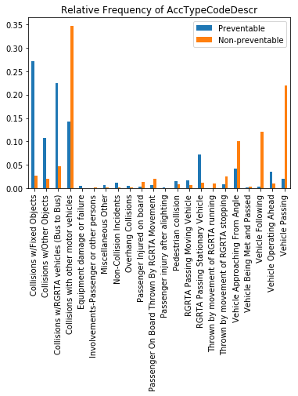
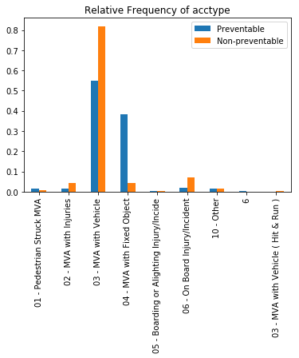
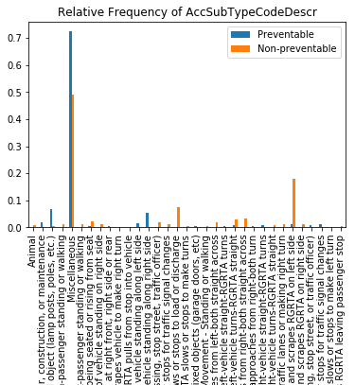
Accident type frequency:
Mostly collisions with objects and other vehicles (896 & 267 over 1314)
Collisions with other vehicles :
Bus to Bus & motor vehicle
Mostly non-preventable
Collisions with objects :
Mostly preventable
Preventable more than Non-preventable:
Collisions with fixed objects
Collisions with other objects
Collisions with RGRTA (Bus to Bus)
Passing Stationary vehicles
Vehicle Operating Ahead

Slide 8
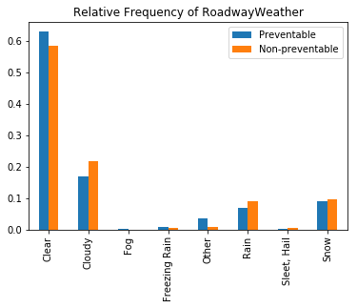
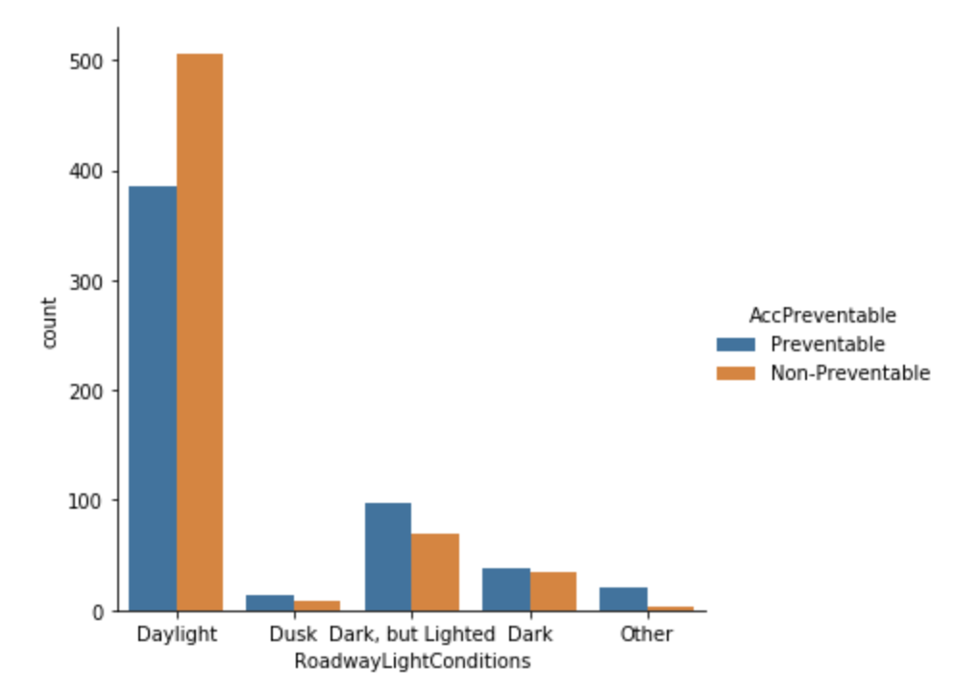
Attributes analysis

Slide 9
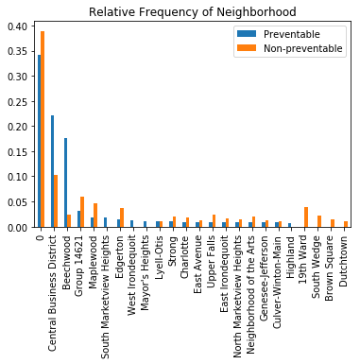
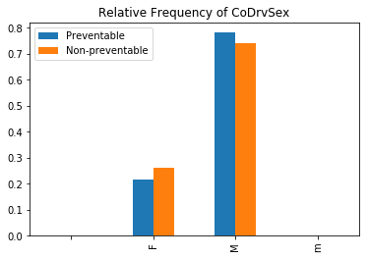
Attributes analysis

Slide 10
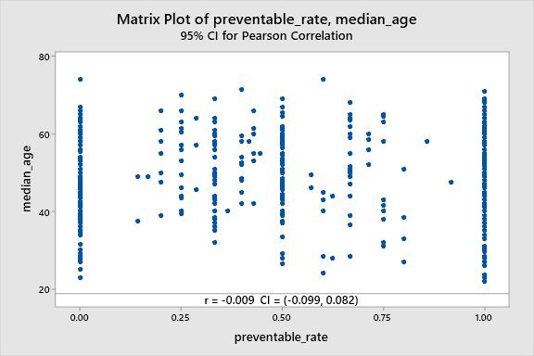
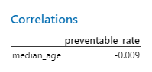
Attributes analysis

Slide 11
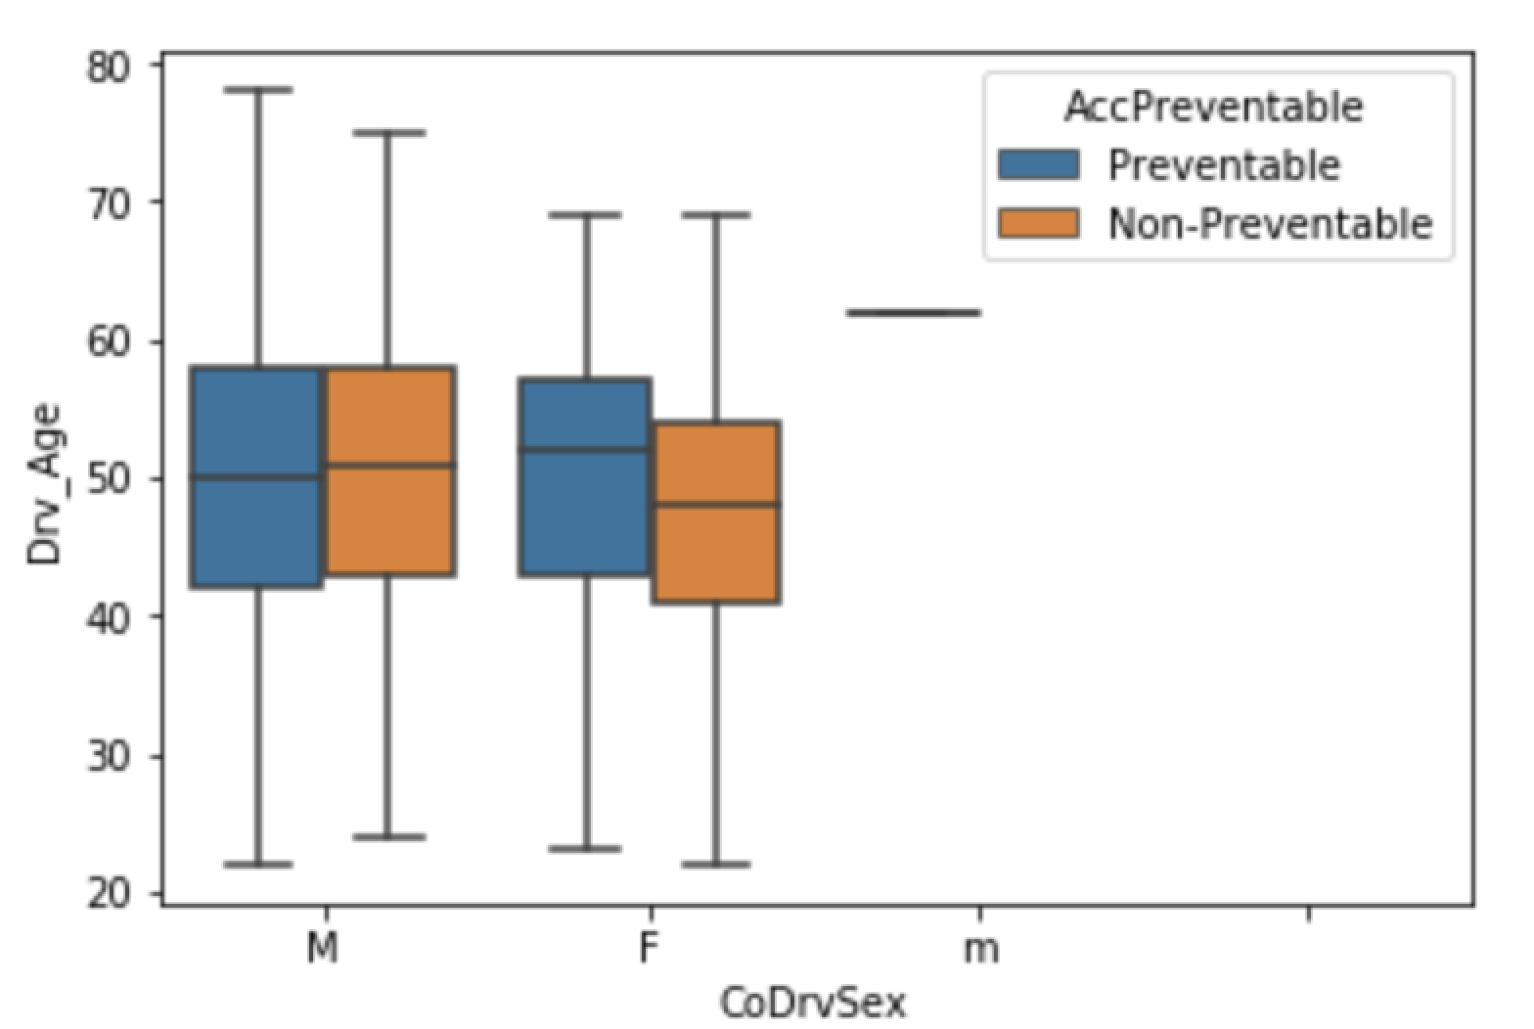
Attributes Analysis
Standardized Gender vs. Age Distribution
Gender and age are not the main factors affecting the frequency of preventable accidents

Slide 12
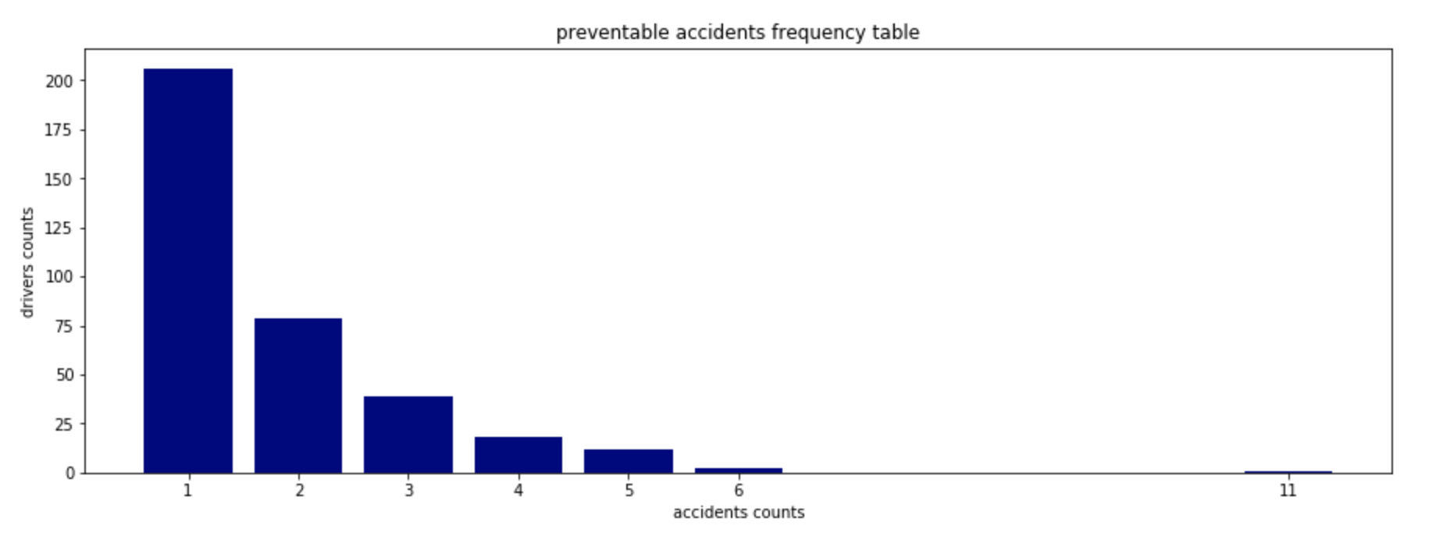
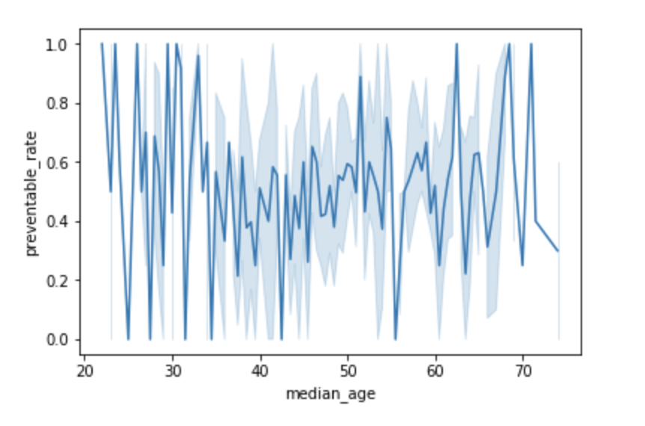

Attributes Analysis
Preventable accidents frequency according to operator ID
Operators who caused more than 5 accidents:
83:11, 238: 6, 273: 6, 275: 5, 506: 5, 487: 5, 197: 5, 480: 5, 388: 5, 323: 5, 493: 5, 66: 5, 218: 5, 214: 5, 61: 5
Operator 323 480 493 506 -> preventable rate ==1

Slide 13
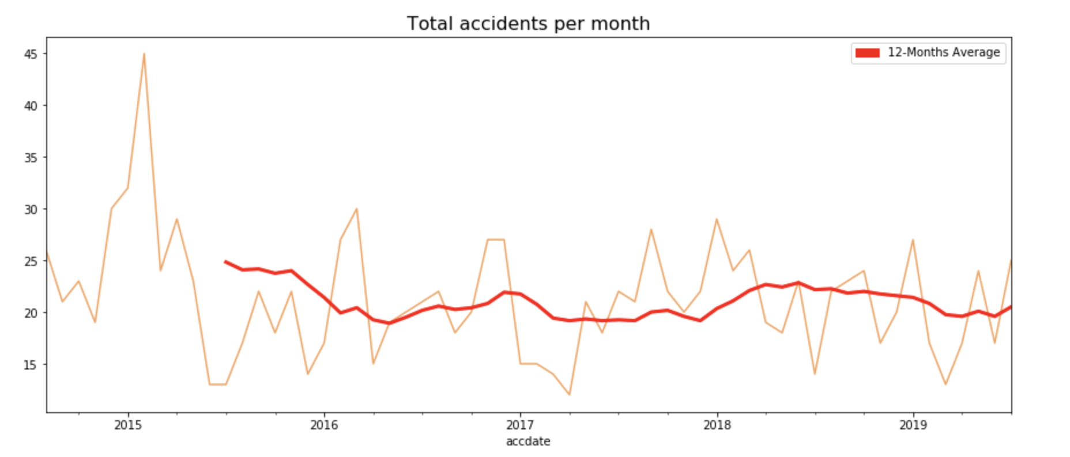
Time Series
Accident date / Accident Frequency
Most accidents happened in winter
Best Month 2017-04 / Worst Month 2015-02
8 Accidents happened on 02/09/2015

Slide 14
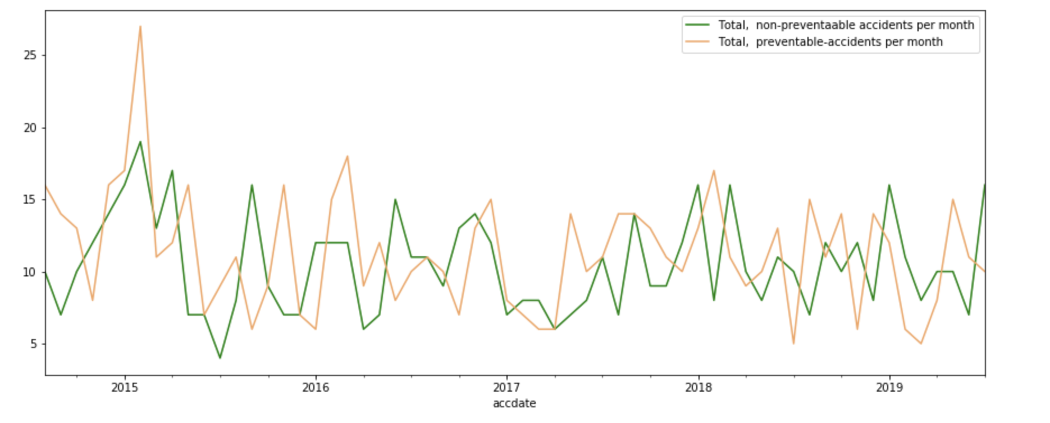
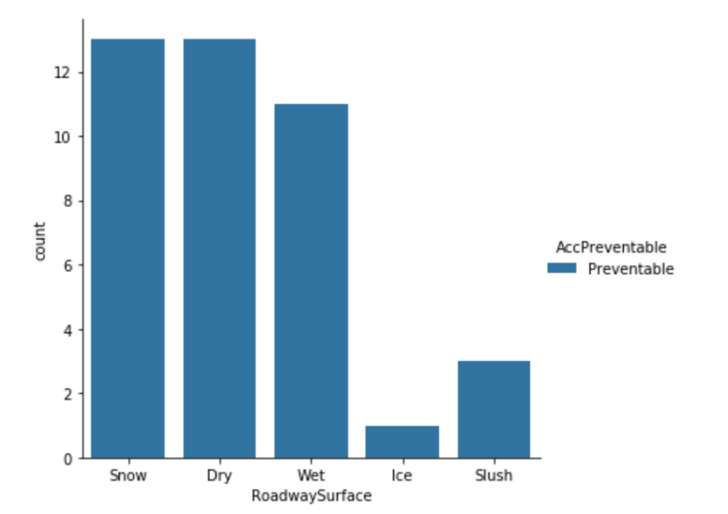
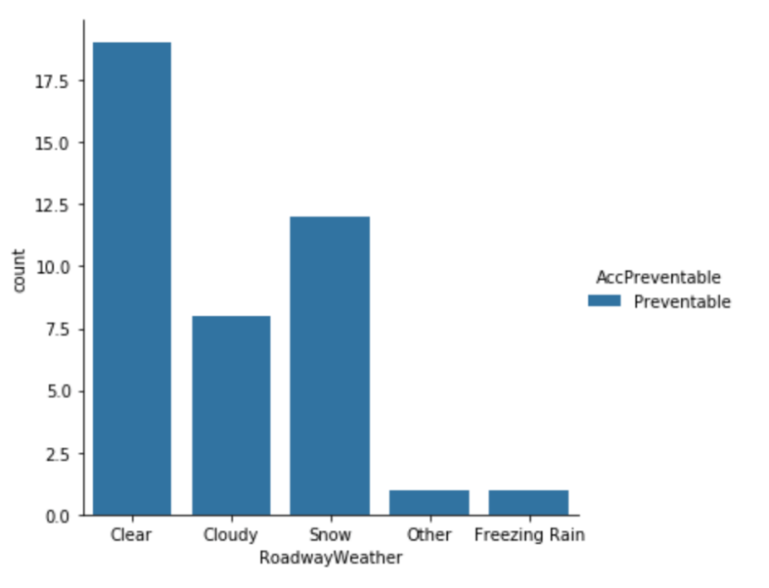
Time Series
Lots of preventable accidents happened in 2016 from January to March
Frequency bar chart:
Lots of Snowy days in that period

Slide 15
02 Map Analysis
Map overview
Route analysis

Slide 16

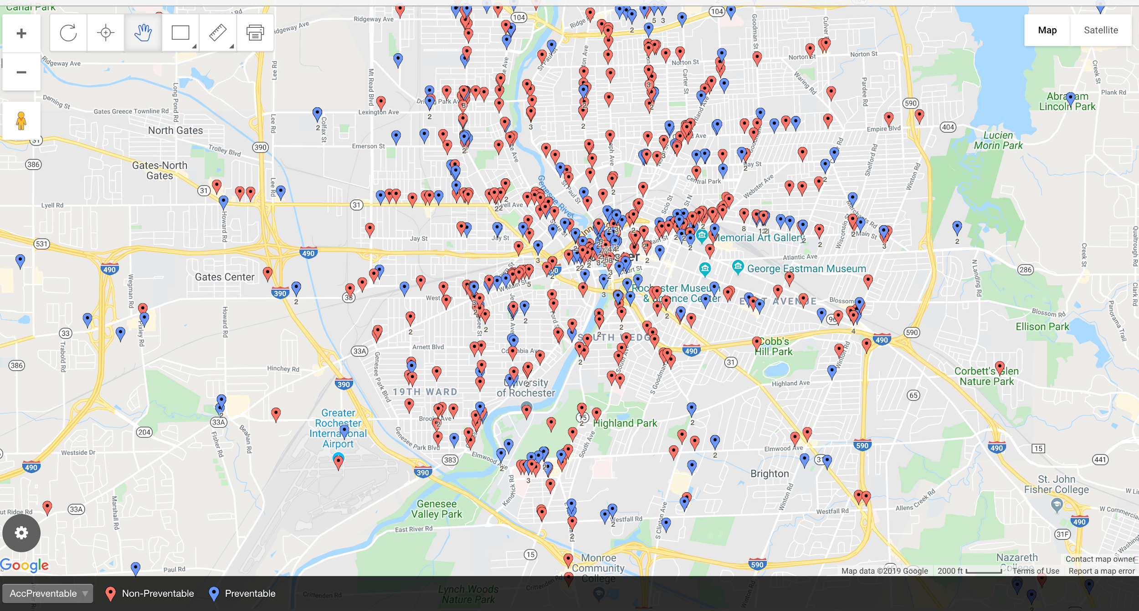
MAP overview
GeoMap of the accidents’ location
Preventable
Non-Preventable

Slide 17

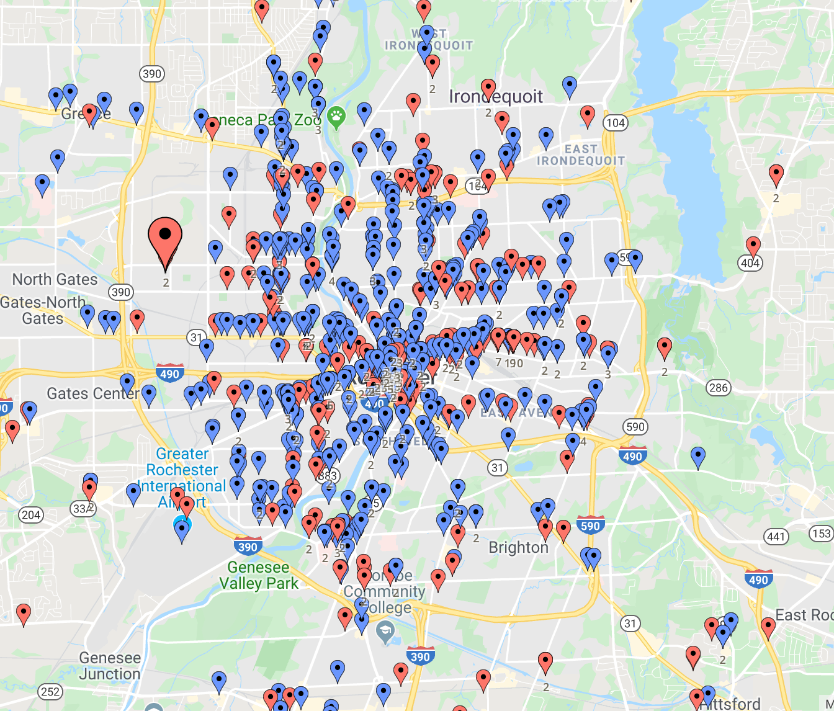


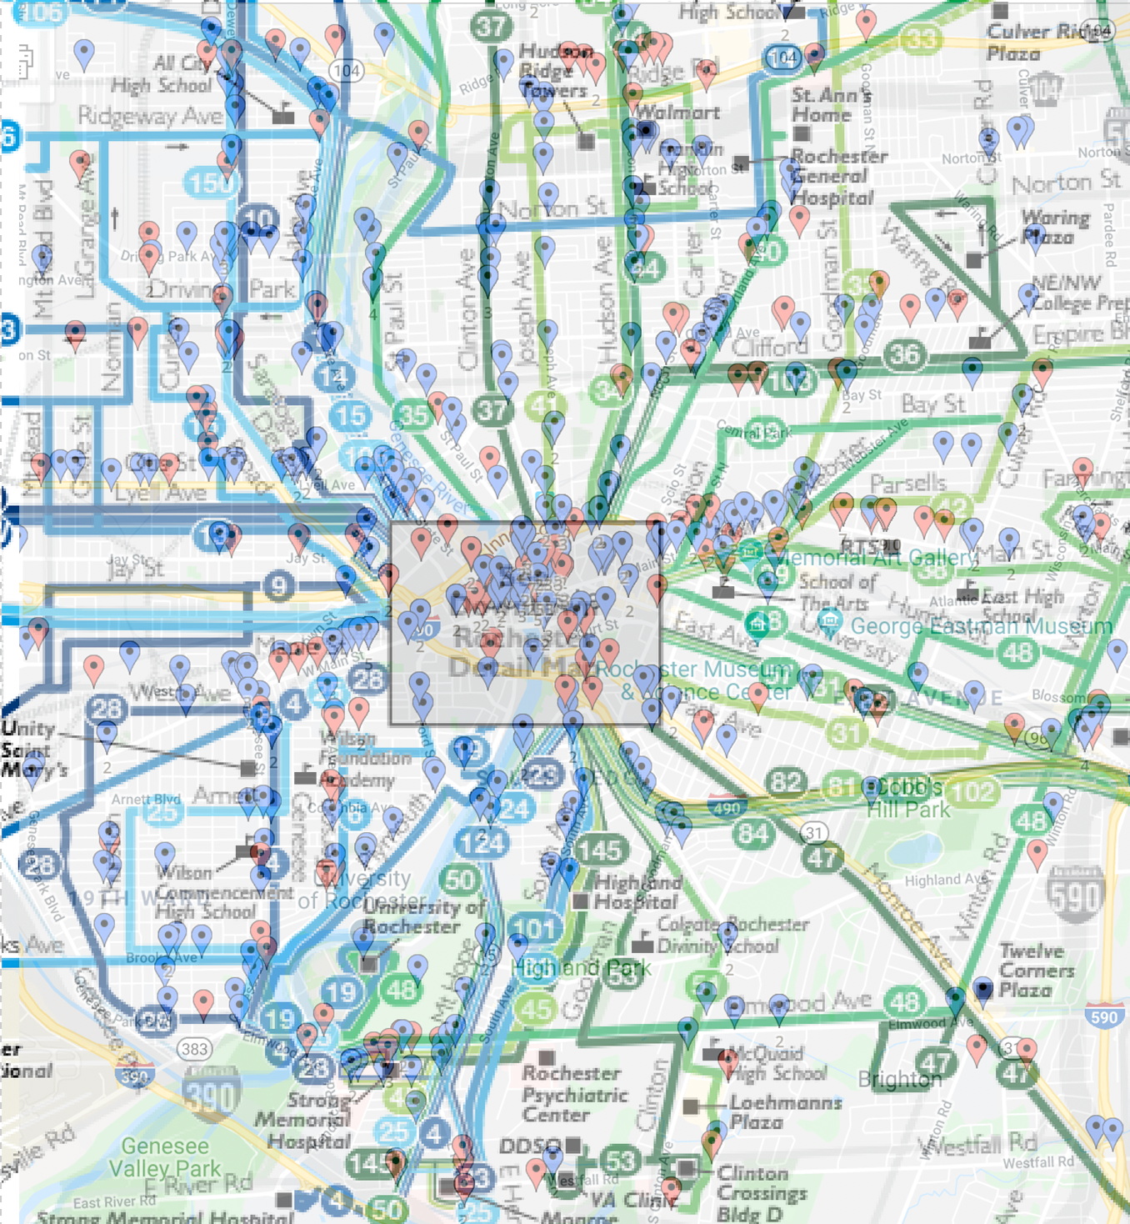











ROUTE ANALYSIS
＃8
＃9
＃10
＃7
＃6
＃11
＃5
＃12
＃4
Rochester
Transit Center
＃3
＃13
＃2
＃1

Slide 18
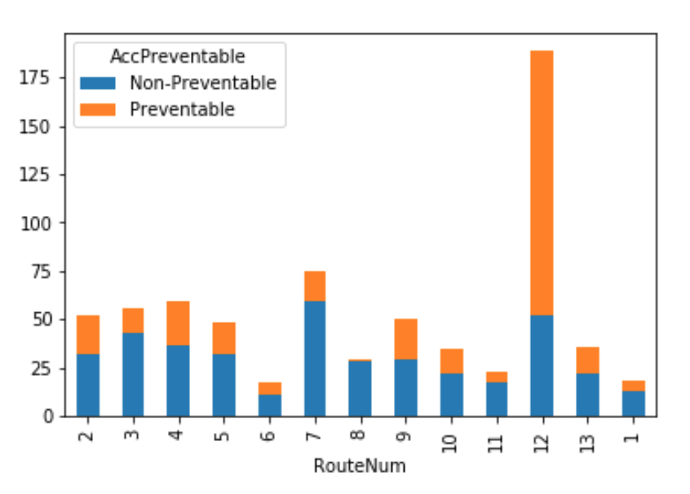
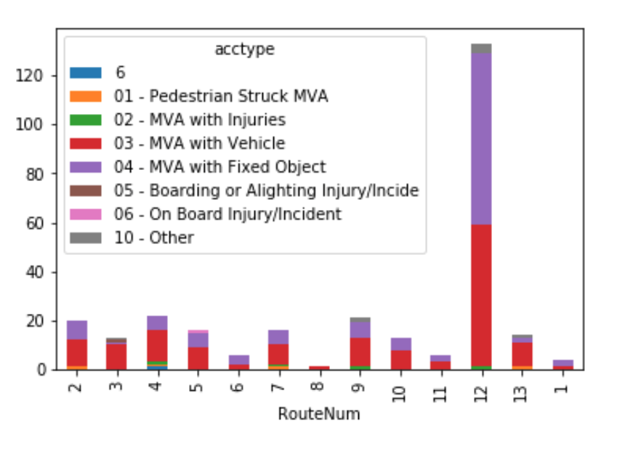
ROUTE ANALYSIS
Route#12 has more preventable accidents than non-preventable accidents
Most accidents on Route#12 are collisions with fixed objects

Slide 19
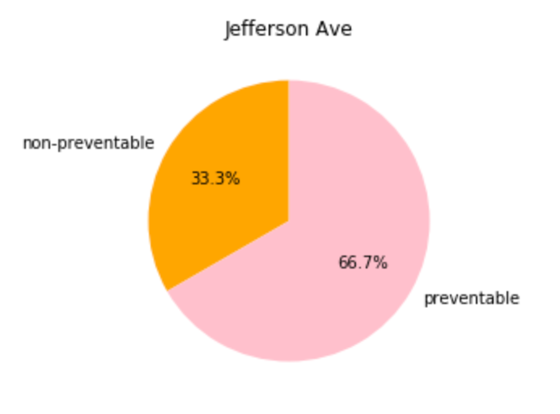
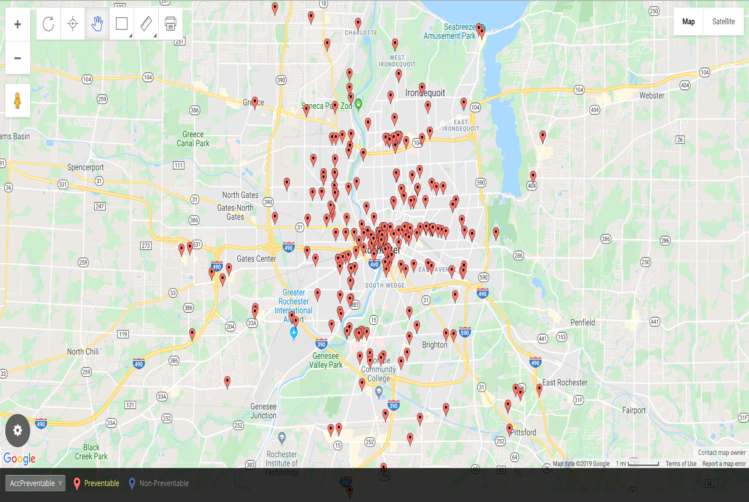
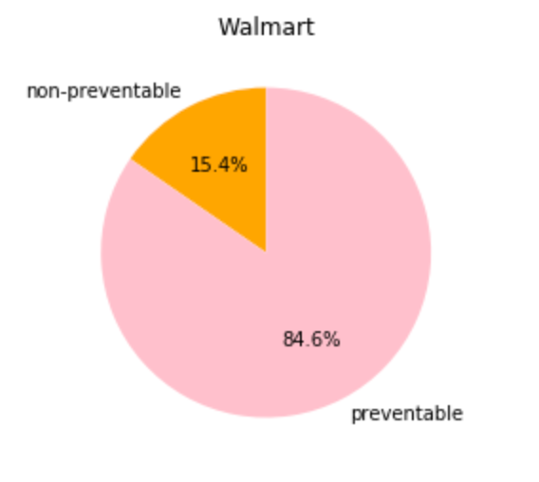
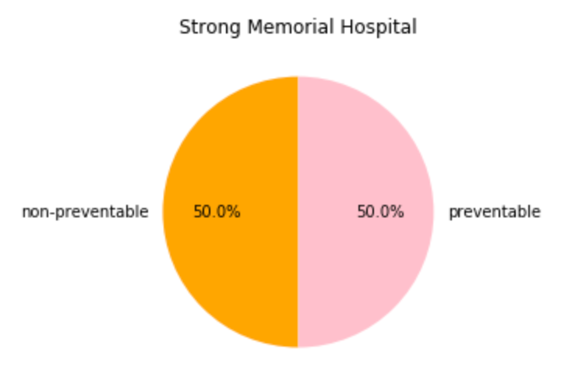
ROUTE ANALYSIS

Slide 20
03 Absence & work type Analysis
Absent days count before accidents
Absence frequency
Work type and accidents frequency

Slide 21
Absent days
Absence end date
Accident date
Calculated the days between these two attributes in order to see the relationship between absence and accident
Notes:
Joined three documents and substracted the date time

Slide 22
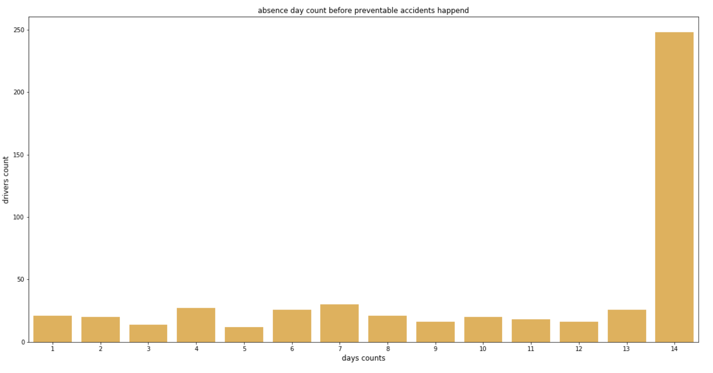
pip install jupyterlab
pip install jupyterlab
14 days

Slide 23
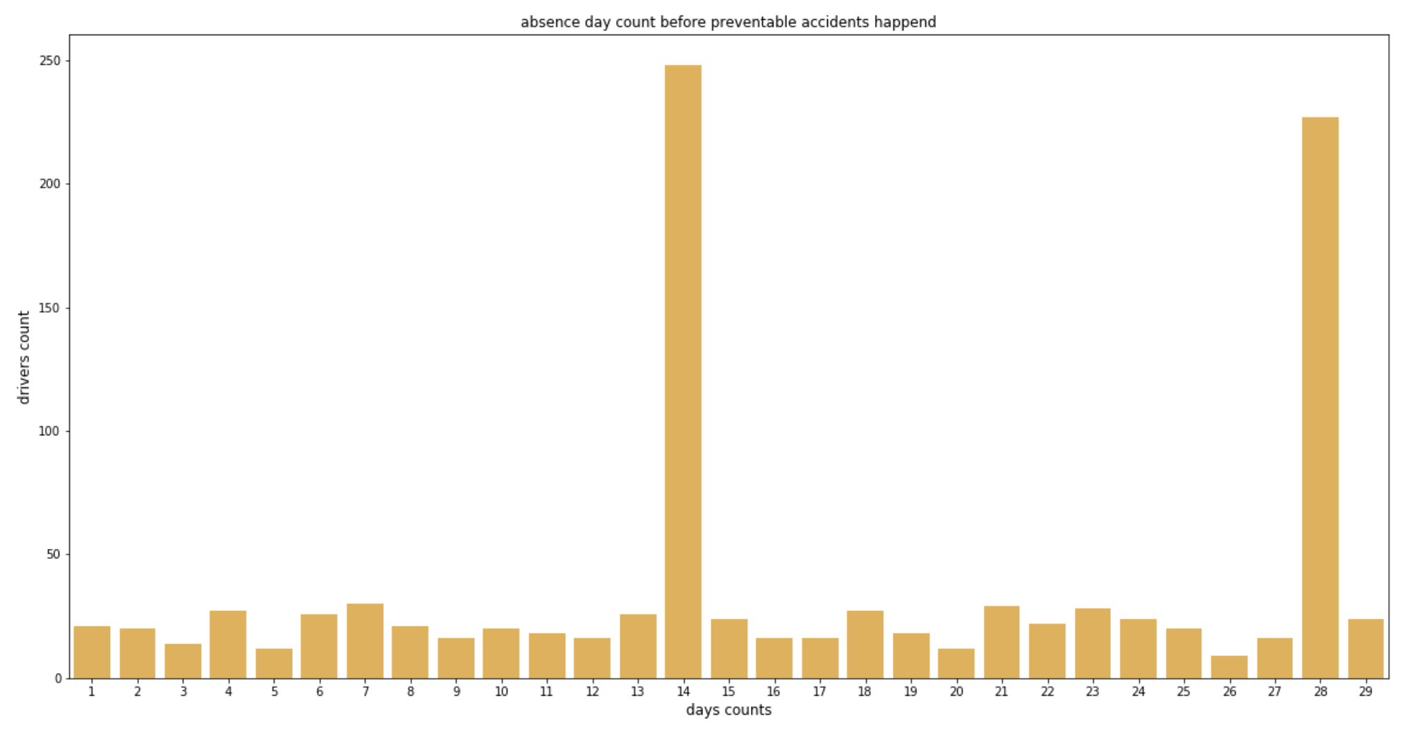
14&28 days
Notes:
There are great amount of accidents happened after the absence / can’t think of exact reasons

Slide 24
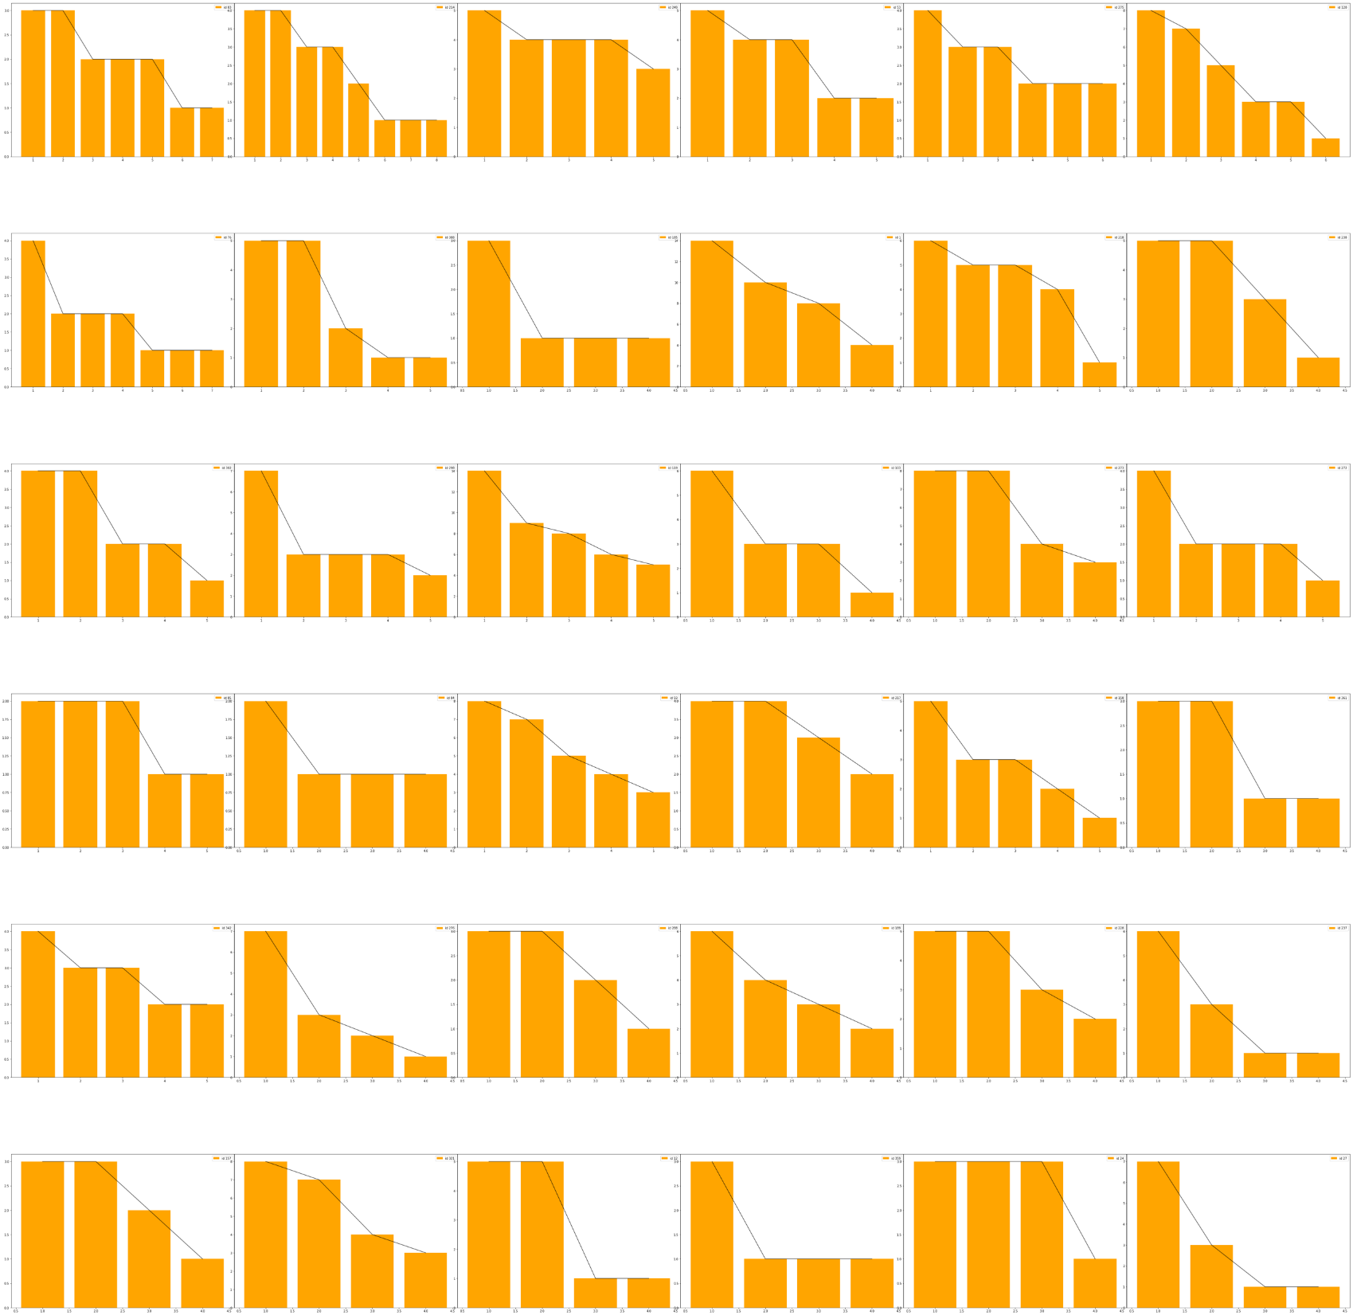

accident>3 = 36
Number of absences before each accident within 30 days
For drivers who made more than 3 accidents, number of absences before each accident decreased to 1 gradually
Generally behaved better after each accident
Drivers who caused lots of accidents wasn’t absent before certain accidents happened

Slide 25
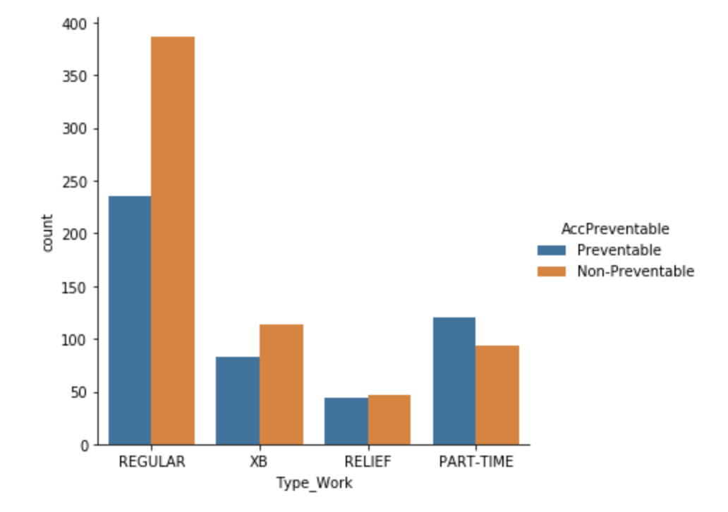
1.Reducing part-time employee numbers
Add extra training specifically targeted only on part-time
Notes:
as we know preventable and non-preventable approximately half and half , Preventable happened more than 30 accidents from part-time employee compared to those who had non-preventable accident , so our suggestion can draw from
1.reducing part-time employee numbers
add extra training specifically targeted only on part-time
in order to reduce preventable accidents

Slide 26
THANKS

